Slide 1
Emerging Leaders programme-Band G-H

Slide 2
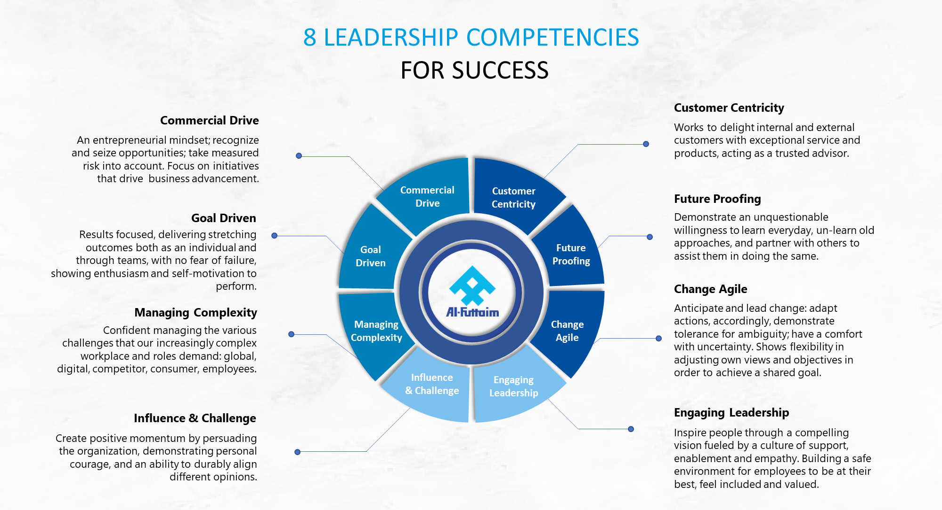
Notes:
As we said earlier part of building your development plan is understanding your current Strengths and Areas for Development and one of the ways is knowing where you stand in the leadership competency
I am sure you are all aware that THE updated leadership competencies is rolled out. We have already expanded each leadership competency into 3 proficiency level, level 1,2 & 3. And if you wish to grow in the leadership ladder, these competencies will give you insights on what you need to demonstrate. If you want to learn more about the competencies based on your band you will now know what is excepted from you.

Slide 3

Emerging Leader Program – 8 Modules
Nov ‘22 - June ’23
Engaging Leadership Personality Styles
Emotional Intelligence
Situational Leadership
Stages of Team formation
Dysfunctions of a Team
Psychological safety
Customer Centricity
Influence & Challenge
Future Proofing
Goal Driven
Vision & Strategy
Coaching
Challenging Conversions
Managing Underperformance
Commercial Drive
Business Model Canvas
Top Line & Bottom-Line Impact Creating New Opportunities
Managing Complexity
Managing Complex environments
Models of Complexity
Systems thinking
Change Agile
The Change Cycle
William Bridges transitions Self-Management during change
Building and Enabling Resistance
Learning Support Groups | Learning Labs | ILT & E-learning | Simulations | Group Mentoring

Slide 4

Emerging Leader Program structure
Business Leader Launch
1 Module per Month
Monthly Post Work : Reinforcers
Quarterly Group Mentoring
LAUNCH
8 LEARNING LABS
SUPPORT GROUP
Post Work
GROUP MENTORING
Leadership 360 Pre-assessment
Learning Journey Series Launch
Creating a Sense of Commitment by senior leader for all participants & their Line Managers
Engaging Leadership
Goal Driven Commercial Drive
The Practical coach Navigating Complexity
Customer Centricity
Future Proofing Change Management
Influence & Inspire
All participants are enrolled in a virtual support MS teams group where they can collaborate and learn from each other
E-learning Pathways on 8 Modules
Together with Implementation and reflection work
L&D and Business Leader
Open discussion and mentoring opportunity driven through the implementation and reflection work done during the quarter
60 mins V/in-class
09:00 – 17:30 hours
E-Learning
Webinar
45 mins
Learning Support Groups | Learning Labs | E-learning | Learning Simulations & Case Studies | Quarterly Group Mentoring

